Slide 1


Effective Public Outreach for Transportation Projects Using Geospatial Analytics
Dr. Okan Pala | opala@ncsu.edu
George Orfanidis | gorfani@ncsu.edu

Slide 2
Transportation Planning Process
Choice of site
Ranking transportation needs
Public input

Slide 3
Problem Statement
Local stakeholders are more likely to get involved in the planning process of it compared to commuting stakeholders
Many stakeholders participate in the planning process to delay the actualization of a project because they simply do not want long term construction near their work or home location.
Local: stakeholders that live or work in close proximity to the project’s location
Commuting: stakeholders that regularly commute near the project’s location

Slide 4

How Does One Effectively Identify Transportation Stakeholders To Target Them Using Popular Advertising Platforms?

Slide 5
Approach Overview
Identification of non affected areas
Network Analysis
Automated targeted advertising
Spatial Engagement Portal
Selection of areas with demographic interest

Slide 6
Network Analysis

Slide 7
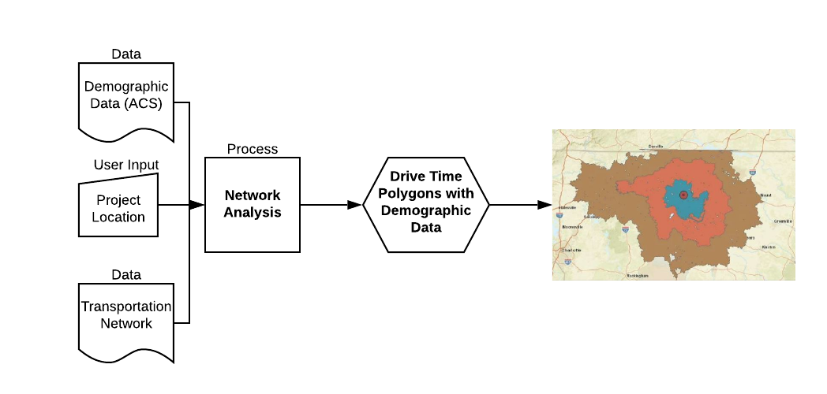
Previous Work
Credit: Xena, Hong (2019)

Slide 8
Identification of not affected areas
Network Analysis

Slide 9
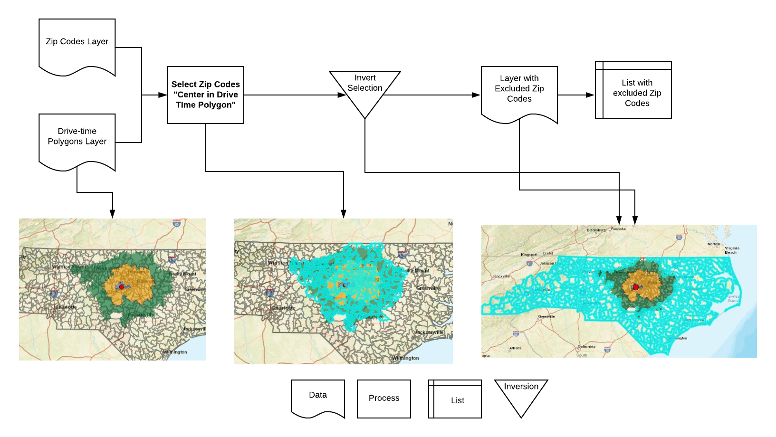
Location Exclusions

Slide 10
Identification of non affected areas
Network Analysis
Selection of areas with demographic interest

Slide 11
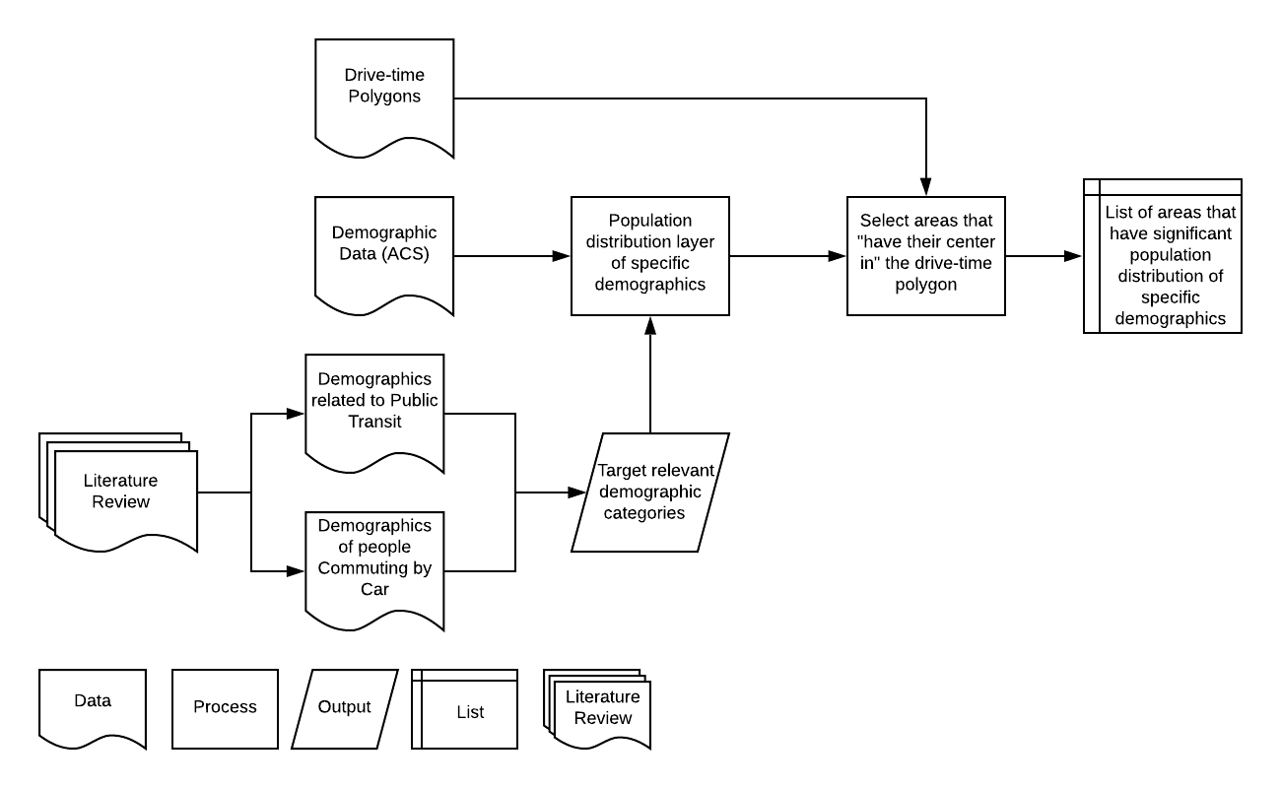
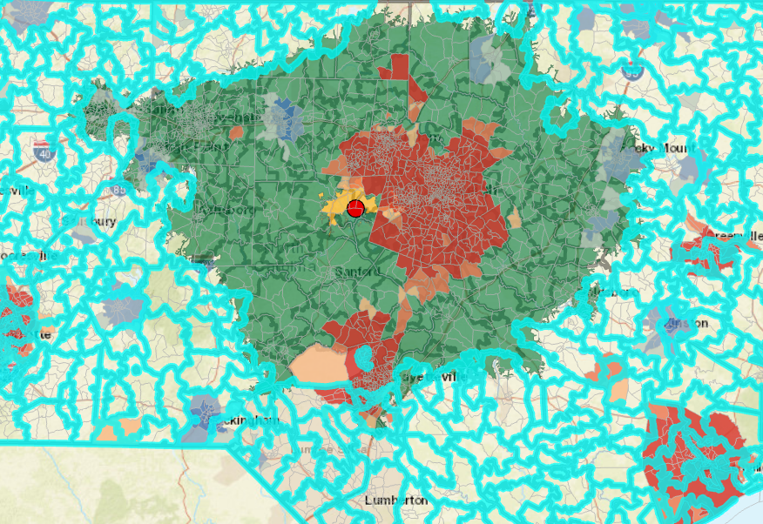
Demographic Targeting

Slide 12
Approach Overview
Identification of non affected areas
Network Analysis
Automated targeted advertising
Selection of areas with demographic interest

Slide 13
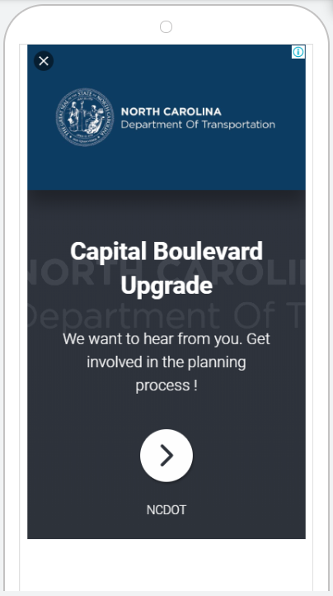

Automated Creation of Campaigns
List with excluded Zip Code, US States and counties
List with areas that have significant population density of specific demographics
Personalized Spatial Engagement Portal

Slide 14
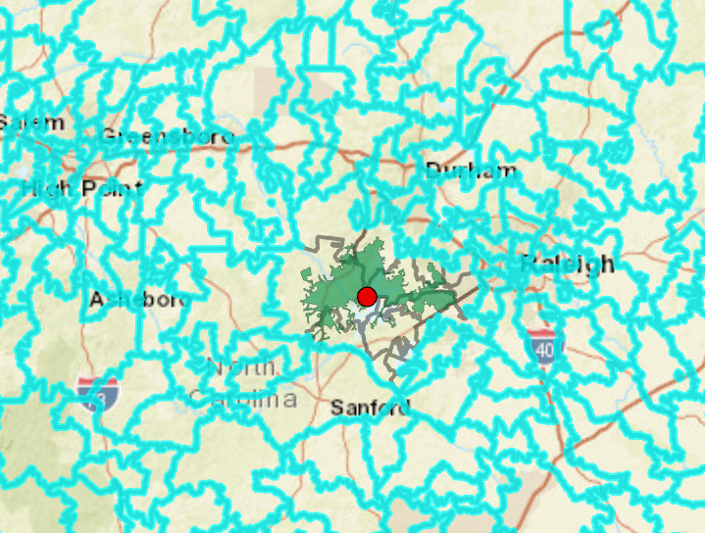

Creating Campaigns
Goal 1: Target local stakeholders

Slide 15
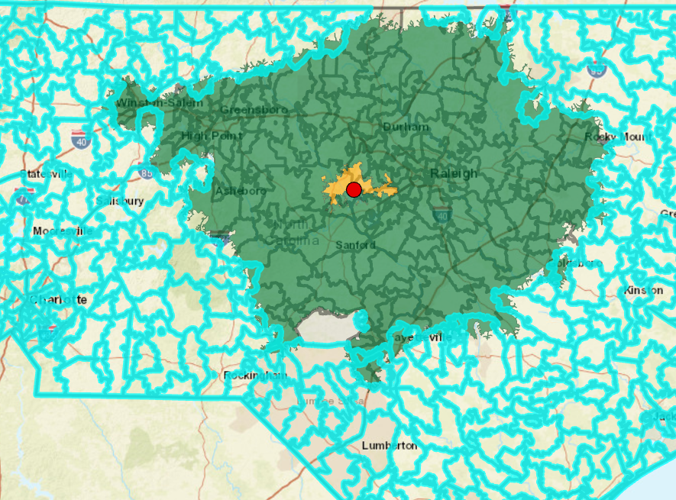
Creating Campaigns
Goal 2: Target nonlocal stakeholders that are related to the project’s location

Slide 16
Creating Campaigns
Goal 3: Target stakeholders that have a greater interest in the proposed transportation project

Slide 17
Approach Overview
Identification of non affected areas
Network Analysis
Automated targeted advertising
Spatial Engagement Portal
Selection of areas with demographic interest

Slide 18

Spatial Engagement Portal

Slide 19
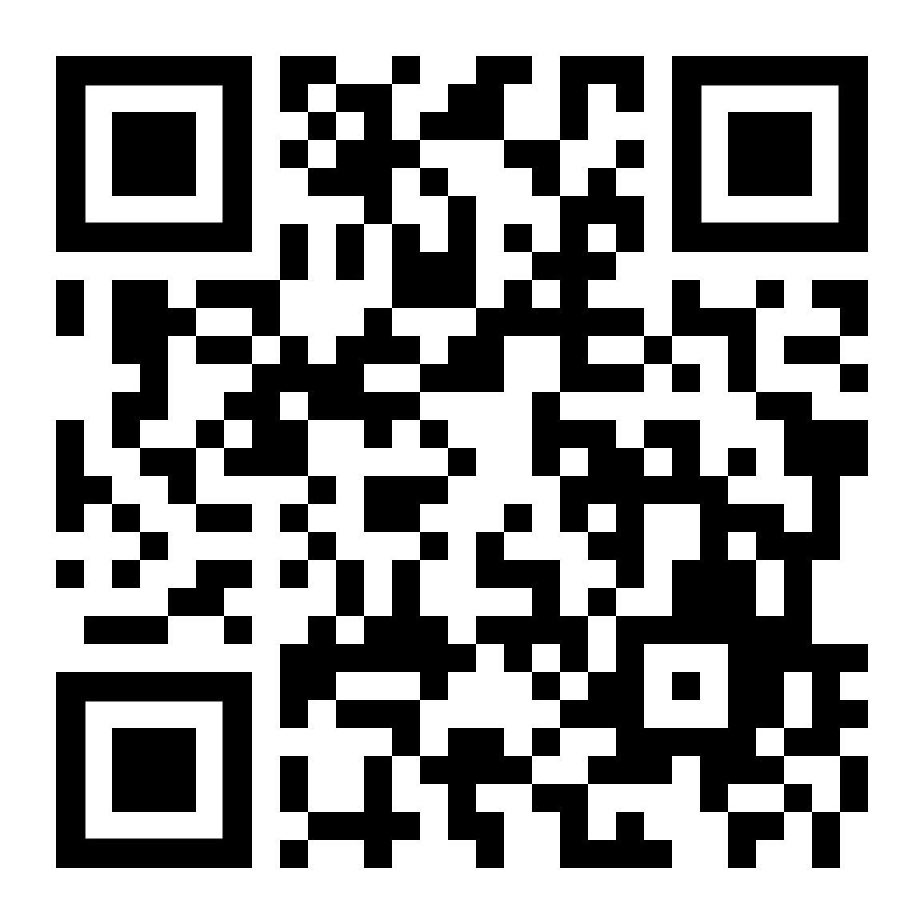
Scan to get access to the recorded presentation and slides

Slide 20
THANK YOU !
ANY QUESTIONS?
Dr. Okan Pala | opala@ncsu.edu
George Orfanidis | gorfani@ncsu.edu

